Slide 1
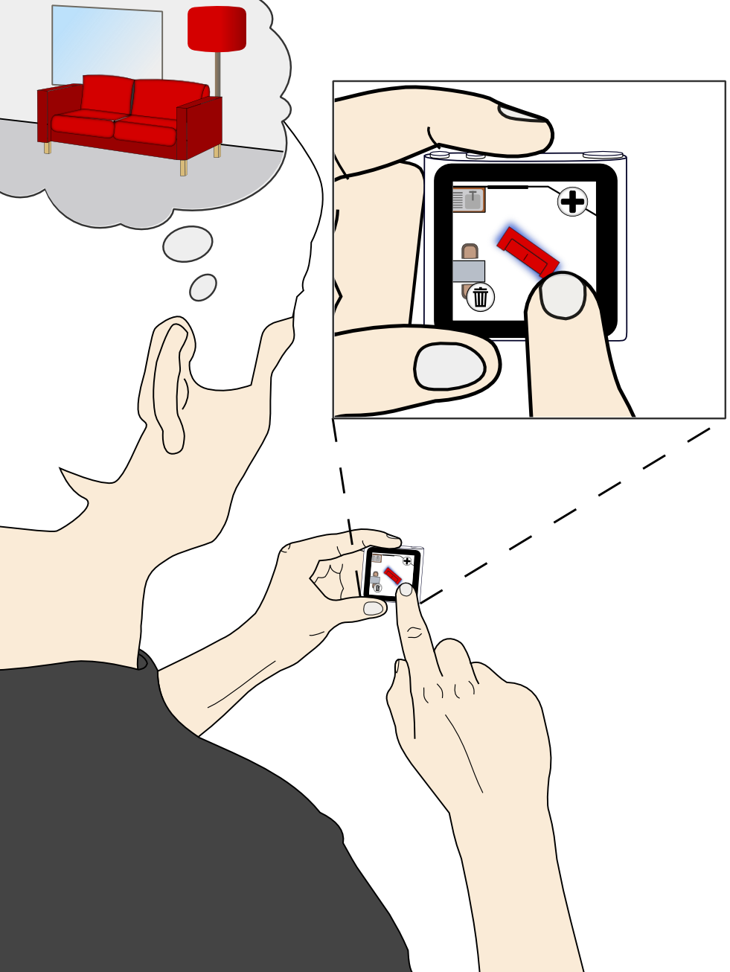
Couch Puzzle : Interactive room planning to go
Tom Bocklisch
Tom Herold
Dominic Bräunlein
Norman Rzepka

Slide 2
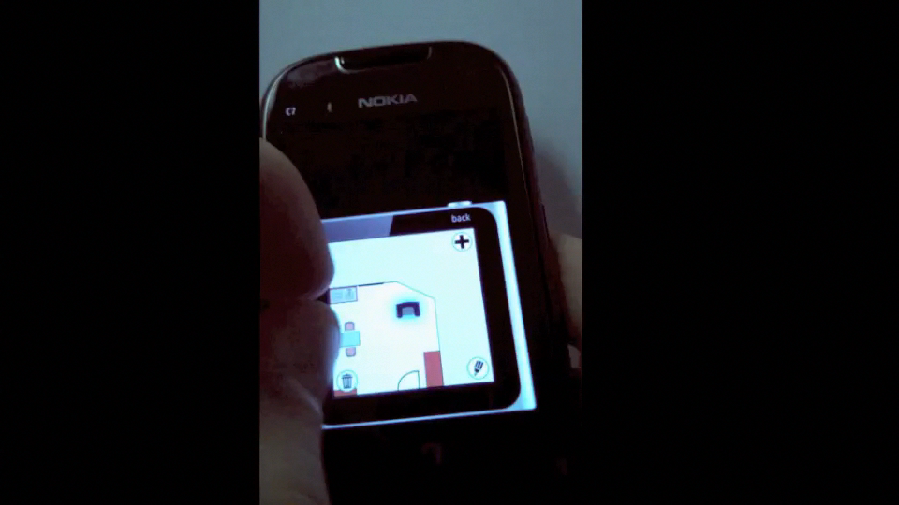

Slide 3
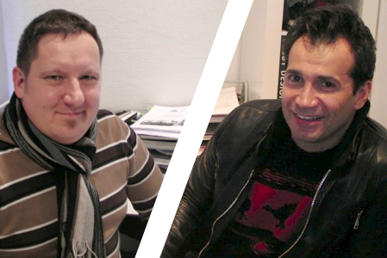
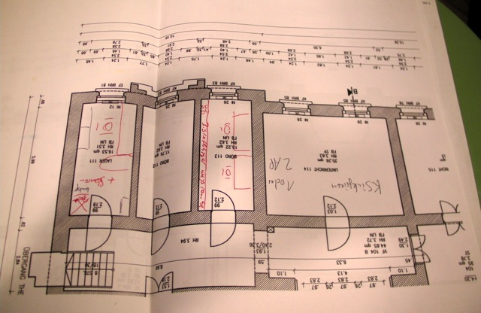
Contextual Inquiry
1
André and Alen – interior designers

Slide 4
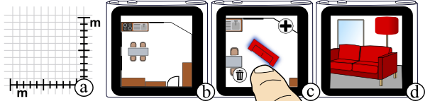
Task Overview
2

Slide 5
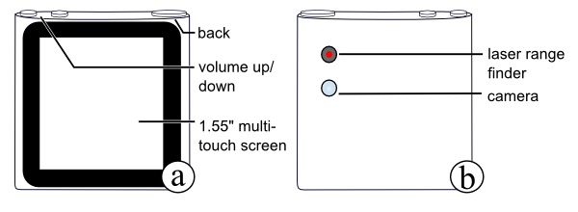
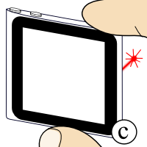
Device
3

Slide 6
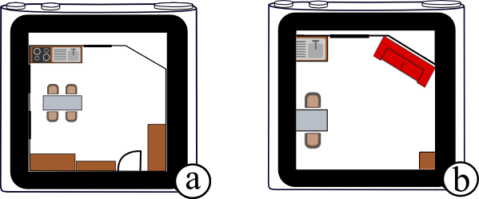
Test Case
4
Add a red, 90x230cm couch to the kitchen and move it to the wall.

Slide 7
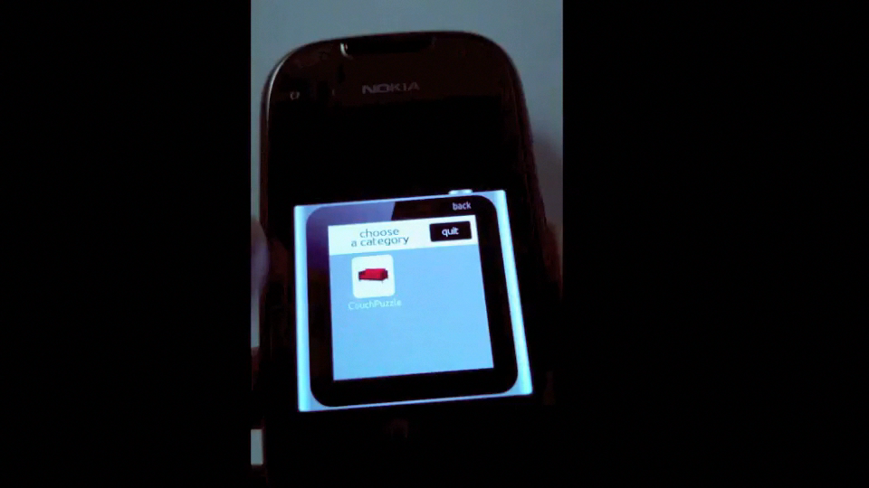
Walkthrough
5

Slide 8
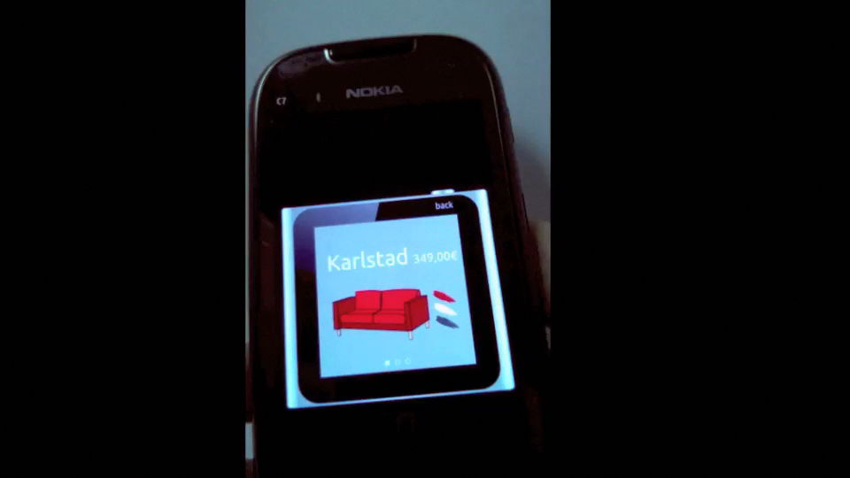
Walkthrough
5

Slide 9
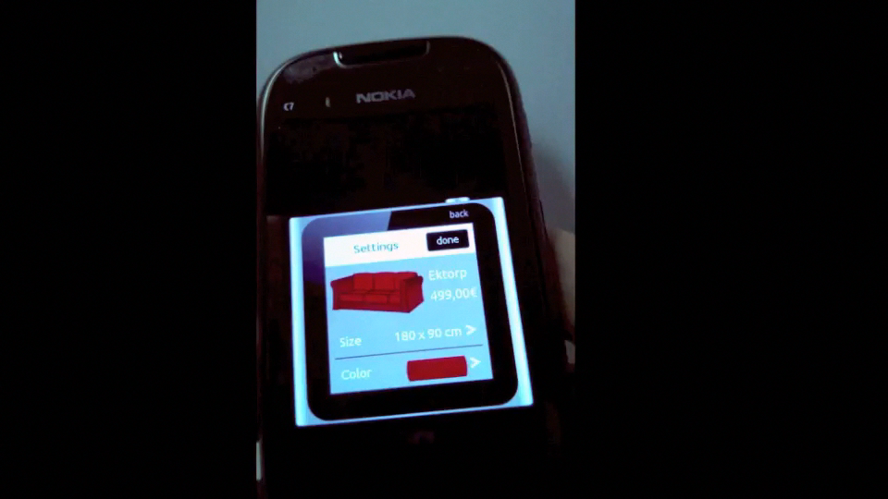
Walkthrough
5

Slide 10
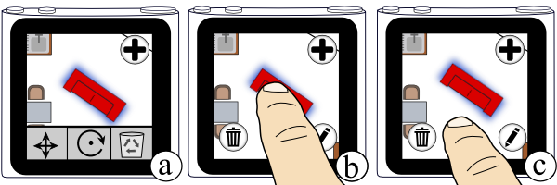
Users expect gestures instead of buttons
6

Slide 11
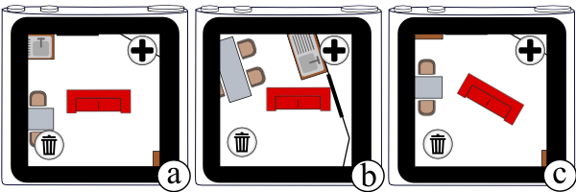
Users lose the orientation when rotating the room
6

Slide 12
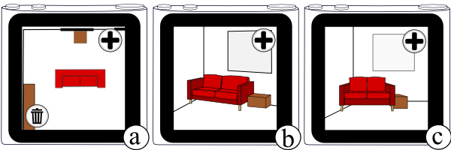
On small devices 3D is not feasible
6

Slide 13
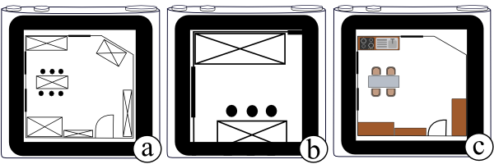
Using schematic textures instead of wireframes
6

Slide 14
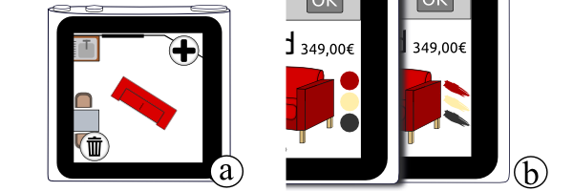
Users associate information elements as action elements
6

Slide 15
Conclusion
7
Direct Room preview
Standard multi-touch gestures

Slide 16
PPTX PPTX PPTX PPTX PPTX PPTX PPTX PPTX PPTX PPTX PPTX PPTX PPTX PPTX PPTX PPTX PPTX PPTX PPTX PPTX PPTX PPTX PPTX PPTX PPTX PPTX PPTX PPTX PPTX PPTX PPTX PPTX PPTX PPTX PPTX

